Slide 1
IOT SECURITY
CARE FOR SOME

Slide 2
WHOAMI
Srdjan Radojcic
BSc Geomatics, MSc Mechatronics
Radio Amateur
Member of Maker community
IoT background (LoRa, Zigbee, BLE, RFID…)
Linux developer

Slide 3
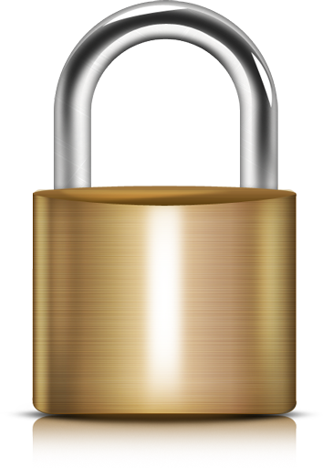

Slide 5
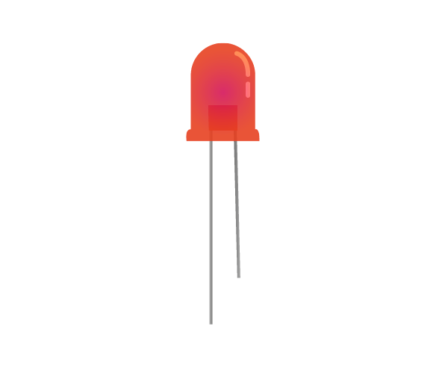
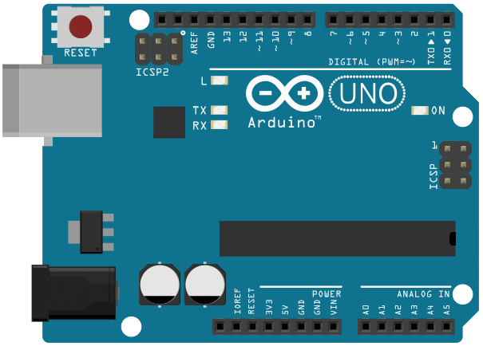
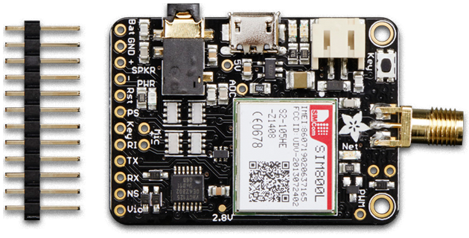
First (IoT) Project

Slide 7
WHAT IS SDR?
Software cheap(??), hardware expensive
Therefore, more software, cheaper hardware
Not everything, ofc. (Really?)
RF front-end

Slide 8
WHAT IS RF FRONT END?

Slide 9
WHAT IS SOFTWARE PART?
In brief, a software radio is a radio system which performs the required signal processing in software instead of using dedicated integrated circuits in hardware. The benefit is that since software can be easily replaced in the radio system, the same hardware can be used to create many kinds of radios for many different transmission standards; thus, one software radio can be used for a variety of applications.
“What is GNU radio?” Wikipedia
So basically, everything else
Algorithms
Middleware
Flexible
One platform to rule them all

Slide 10
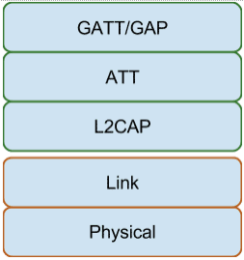
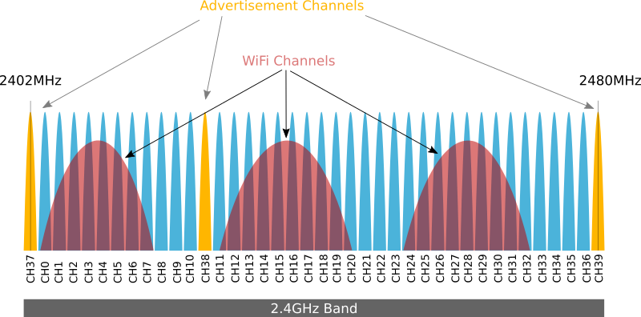
BLUETOOTH LOW ENERGY
GFSK
40 channels in 2.4
Hopping
3 channels, advertising
37 channels, data

Slide 11
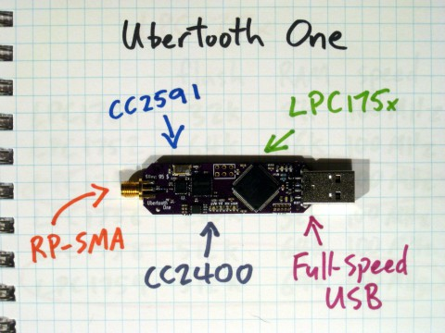
UBERTOOTH
RF front end
Wireless Transceiver
ARM processor
PHY layer
Link layer
Packets

Slide 12
A LITTLE BIT ABOUT LINK LAYER
What do we need to sniff Bluetooth?
Access address
CRC
Channel(Hop interval, hop increment)
Two cases
Advertainment channel
Data channel

Slide 13
PARTY STARTED WITHOUT ME ☹
Identify Access address (xx100010111101000000000000000101010xx)
Determining hopping interval (t/37 = hop interval)
Determining hopping increment ()

Slide 14
WIRESHARK
Run the command: mkfifo /tmp/pipe
Open Wireshark
Click Capture -> Options
Click "Manage Interfaces" button on the right side of the window
Click the "New" button
In the "Pipe" text box, type "/tmp/pipe"
Click Save, then click Close
Click "Start"

Slide 15
SO PDU IS ENCRYPTED, RIGHT?
4.0/4.1 BLE pairing
Just (doesnt)WorksTM
Out of Band pairing (TK could be strong, NFC etc)
Passkey
4.2 BLE pairing
New pairing method, Numeric comparison, both devices needs to have display
ECDH Key Echcange

Slide 16
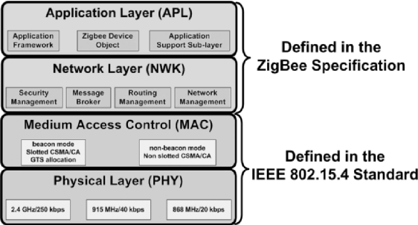
ZIGBEE SECURITY OVERVIEW
Low Cost ☺
Low Power ☺
Low to moderate range
DSSS
CSMA-CA
16 channels
Actually, it is not bad
Few notes for developers:
802.15.4 security MAC turned off by default

Slide 17
ZIGBEE SECURITY, THEORY
Symmetric encryption(AES 128)
Message Authentication
Integrity protection (MIC)
Replay protection
Network key(ALL devices)
Link key(Two devices)

Slide 18
ZEGBEE SECURITY, REALITY
They imagine it right
So, how whey implemented it?
Keys
Preinstalled
Out of Band
Key establishment
Trust centre default LINK key
NDA-protected shared master key
Signal strength
No pair key

Slide 19
TOOLS FOR SNIFFING
USAP
Kisbee (Kismet)
CC2531(Very nice software TI SmartRF Protocol Packet Sniffer)
Atmel RZRAVEN(killerbee)

Slide 20
Keynotes about LoRa
LoRa(Long Range)
868/915 MHz
8 Channels
Unique CSS modulation
LoRa vs LoRaWAN

Slide 21
LoRa join
OTAA
Node has unique 128bit APPkey
Message is not encrypted but signed
Server calculates AppSKey and NwkSkey
ABP
No need for joining
Unique DevAdr + AppSKey and NwkSkey
“Each device should have a unique set of NwkSKey and AppSKey. Compromising the keys of one device shouldn't compromise the security of the communications of other devices.”
“The process to build those keys should be such that the keys cannot be derived in any way from publicly available information (like the Node address for example)”

Slide 22
Key notes about...
RFID
Garage doors
Cars

